Slide 1
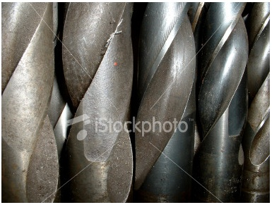
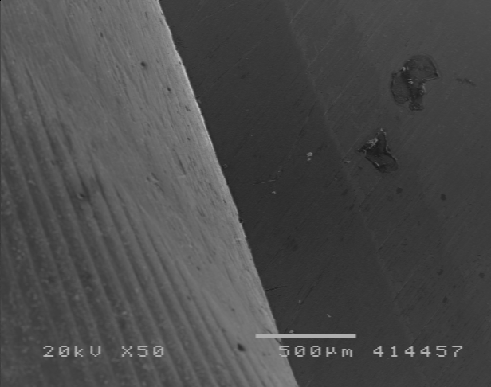
e- beam
surface
flute
See the cross section diagram at right and assume for ease of calculations, that the curve of the drill bit flute is actually straight; the hypotenuse of the blue 45, 45, 90 degree triangle. Using a calibrated image in image J, can you approximate depth of field (D) at different working distances in the 50x magnification images? How does it match up with calculated D from your lab?
Hint: Make the images full screen to examine but don’t use the zoom feature of image J or the entire image looks ‘blurry’.
D?
D?
Also assume that the tangent to the surface of the drill bit is oriented at 90 degrees to the beam axis of the SEM.

Slide 2
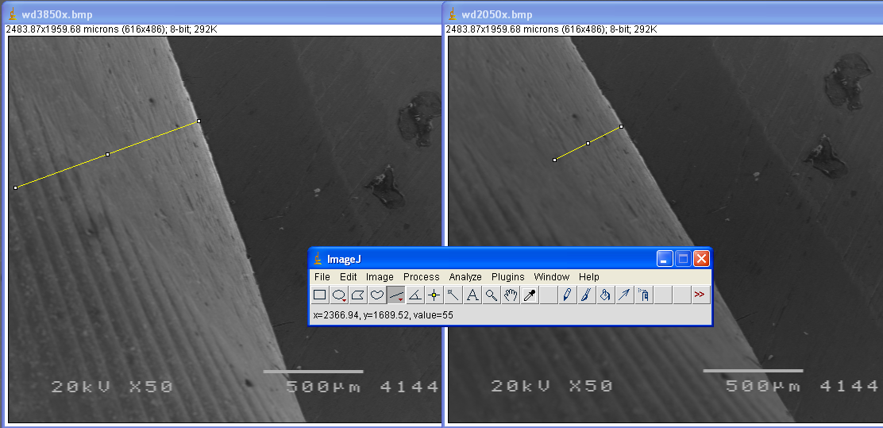
This is just a suggestion, do your own measurements for your percieved depth of field.

