Slide 1
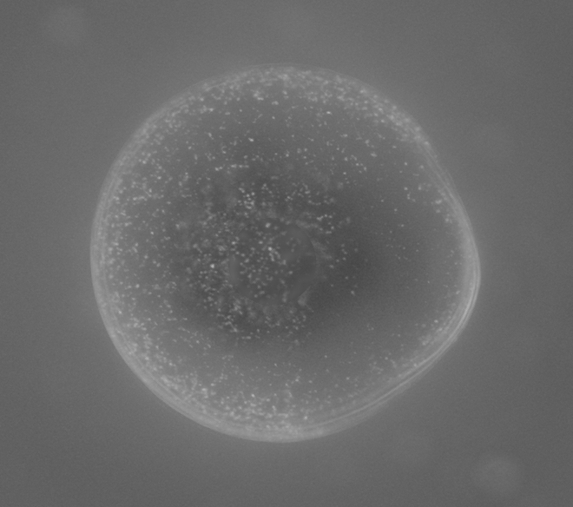
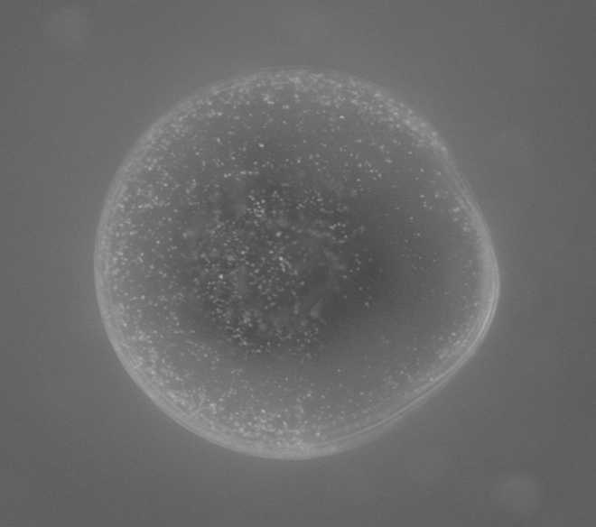
Why a bitmap (.bmp), not a .jpg? If you cannot save a .bmp, make it an uncompressed .tif. This image is of mouse egg labeled with metal nanoparticles – it is a light micrograph with the display table inverted (dimmer light appears white with inverted display).
Compression (of this 8-bit 397,000 pixel image):
none (397kb memory) medium (12kb) high (5kb)
.bmp
.jpg
.jpg
Caution: powerpoint software has resampled these images, blurring image pixels so that original resolution is lost, see next slide for clear example

Slide 2
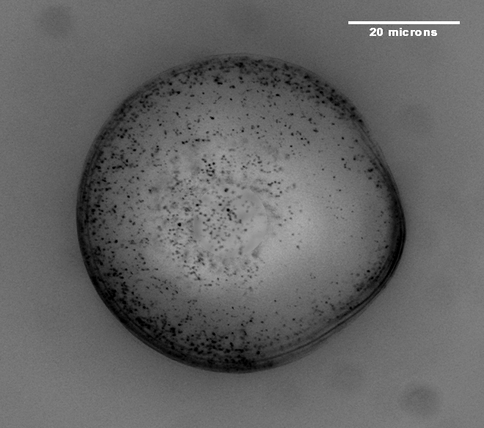
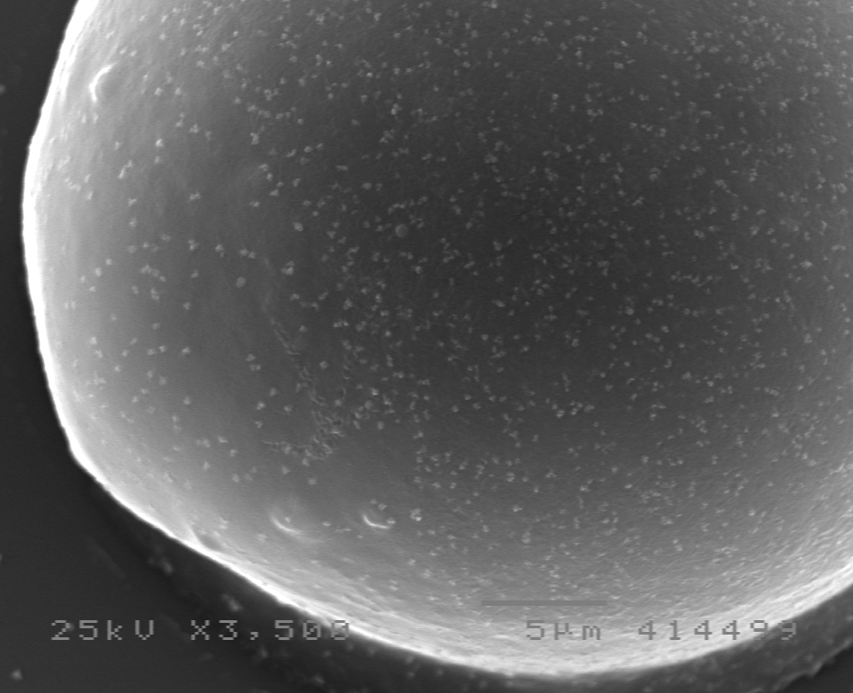
Transmitted light micrograph (non-inverted display table)
Scanning electron micrograph
true pixels (visible with screen capture)
.pptx blurred
true pixels (visible with screen capture)
.pptx blurred

Slide 3
The digital bitmap
We have a map of pixels, each with a coordinate in and y (and sometimes z). Each also has an intensity value defined by the bits of computer memory.
z
x
y
BITMAP A Cartesian or Gaussian map of intensities (bits). We can think of 3D data as stacks of 2D maps. (not always the case).

Slide 4
First must identify and quantify object space and image space
-Dimensions of object space
-Dimensions of image space
-Dimensions of each data point (pixel or voxel) in image space
Using the above information, how do we define magnification?

Slide 5
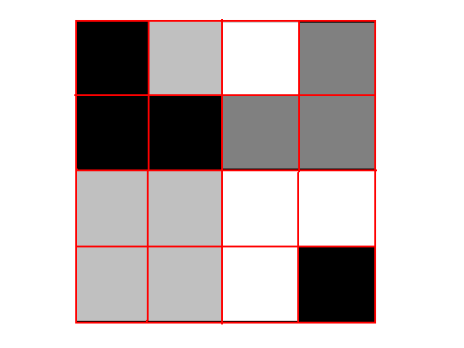
What is digital image data (bit depth)? Each pixel has a value, the more possible values a pixel has (bit depth), the more depth it is said to have.
this is a representation of an 8-bit image, total of 16 pixels. This looks like a greyscale Look Up Table (LUT). See below.
Base 2 math
2 levels, black or white 1 bit
256 levels of grey 8 bit
(or any other color)
65536 levels (check the # 16 bit of the last row of an .xls file)
16.7 million levels 24 bit or 3 x 8 bit (usually it is 8 bits each Red Green & Blue)
How much memory will this (8 bit pixel depth) image consume?
Each pixel gets 8 bits of storage space. 8 bits = 1 byte of memory.
0
180
255
120
0
0
120
120
180
180
255
255
180
180
255
0
When given image data (a photo, drawing, or micrograph), the display computer must look at the chosen LUT to know how to display the data.

Slide 6
8 bit image – each pixel is ranked 0-255
24 bit image - 3 - 8 bit images overlaid (~16.8 million colors)
Usually Red + Green + Blue
the numbers below depict a single 8-bit byte, each pixel gets one of these bytes in an 8 bit image
1 bit (2¹) = 2 tones
2 bits (2²) = 4 tones
3 bits (2³) = 8 tones
4 bits (2⁴) = 16 tones
8 bits (2⁸) = 256 tones
16 bits (2¹⁶) = 65,536 tones
24 bits (2²⁴) = 16.7 million tones
y n
2⁰ y or n 1 0
2¹ y or n 2 0
2² y or n 4 0
2³ y or n 8 0
2⁴ y or n 16 0
2⁵ y or n 32 0
2⁶ y or n 64 0
2⁷ y or n 128 0
In digital data we talk about each bit being a 1 or 0 (yes or no). See the table at left and notice how you can get to any number between 0-255 by combining the 8 bits (y or n) of data.
1 byte computer memory = 8 bits

Slide 7
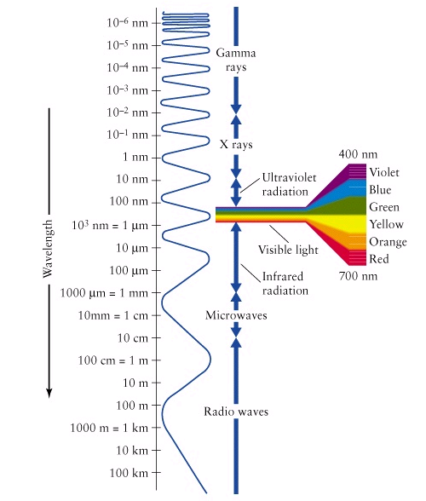
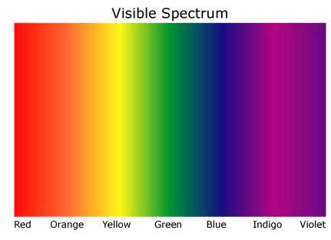
http://www.wit.ie/Research/ResearchGroupsCentres/Groups/MPRG/AgeRelatedMaculaDegeneration/RadiationAndAMD/ElectroMagneticSpectrum.jpg
http://www.voteview.com
The levels of 0-255 in an 8 bit image must each be assigned a color or intensity, only 256 different colors or intensities are available. An RGB or ‘true color’ image combines levels of red, green, & blue to give almost 17,000,000 color variations (this coding includes intensity and color).
The only way to know what object information a digital image represents (8 or 24 bit) is to know what sort of detector system collected the signal from the sample.

Slide 8
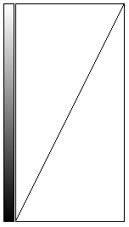
8 bit Look up table from image J
255
0-255 display levels on y axis
0
255
this display level bar shows 256 levels of grey, this is probably greys.lut in image J
0-255 data levels on x axis

Slide 9
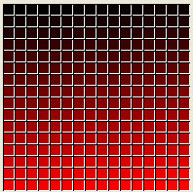
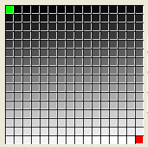
data column | display columns
one channel only
 | Red Green Blue
0 | 0 0 0
1 | 1 1 1
2 | 2 2 2
3 | 3 3 3
. | . . .
. | . . .
128 | 128 128 128
. | . . .
. | . . .
255 | 255 255 255
data column | display columns
one channel only
 | Red Green Blue
0 | 0 0 0
1 | 0 0 1
2 | 0 0 2
3 | 0 0 3
. | . . .
. | . . .
128 | 0 0 128
. | . . .
. | . . .
255 | 0 0 255
data column | display columns
one channel only
 | Red Green Blue
0 | 0 0 0
1 | 1 0 0
2 | 2 0 0
3 | 3 0 0
. | . . .
. | . . .
128 | 128 0 0
. | . . .
. | . . .
255 | 255 0 0
data column | display columns
one channel only
 | Red Green Blue
0 | 0 255 0
1 | 1 1 1
2 | 2 2 2
3 | 3 3 3
. | . . .
. | . . .
128 | 128 128 128
. | . . .
. | . . .
255 | 255 0 0
GREY LUT
8-bit data is defined by the imaging device and data storage devices
8-bit display palate is defined and limited by the display computer hardware and software. For example, a grey scale monitor cannot display all the colors of the rainbow!
If we were to use a greyscale monitor, the LUT (display columns shown at left) would not require separate display columns for R, G, and B because only grey is possible, one display column would suffice
256 levels/pixel
These squares do not represent individual pixels. Each box is one of the possible display tones that can be assigned to any pixel in the image.
BLUE LUT
256 levels/pixel
RED LUT
256 levels/pixel
SETCOL LUT
256 levels/pixel
Try to make different LUTS with image J LUT editor

Slide 10
data column | display columns
one channel only
 | Red Green Blue
0 | 255 255 255
1 | 0 0 0
B&W LUT
1-bit data
usual 1-bit display is black or white but it can be any 2 colors or shades that the display hardware can display
2 levels/pixel
data column | display columns
one channel only
 | Red Green Blue
0 | 0 255 0
1 | 255 0 0
R&G LUT
2 levels/pixel
24-bit display is considered not to have a single LUT. In reality, it must have some type of display LUT for each of its 3 8-bit data channels, total 24-bit data. That is, the PC/display must have a LUT for each color, then combine them via display hardware
data column | display columns | data column | display columns | data column | display columns
channel 1 | Red Green Blue | channel 2 | Red Green Blue | channel 3 | Red Green Blue
0 | 0 0 0 | 0 | 0 0 0 | 0 | 0 0 0
1 | 1 0 1 | 1 | 0 1 0 | 1 | 0 0 1
2 | 2 0 0 | 2 | 0 2 0 | 2 | 0 0 2
3 | 3 0 0 | 3 | 0 3 0 | 3 | 0 0 3
. | . . . | . | . . . | . | . . .
. | . . . | . | . . . | . | . . .
128 | 128 0 0 | 128 | 0 128 0 | 128 | 0 0 128
. | . . . | . | . . . | . | . . .
. | . . . | . | . . . | . | . . .
255 | 255 0 0 | 255 | 0 255 0 | 255 | 0 0 255
16.8 million levels/pixel
This spreadsheet is set up as a typical, 3 channel, 24-bit, Red, Green, Blue color image.

Slide 11
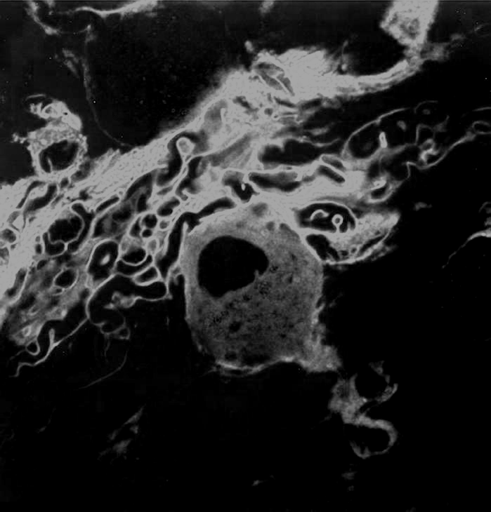
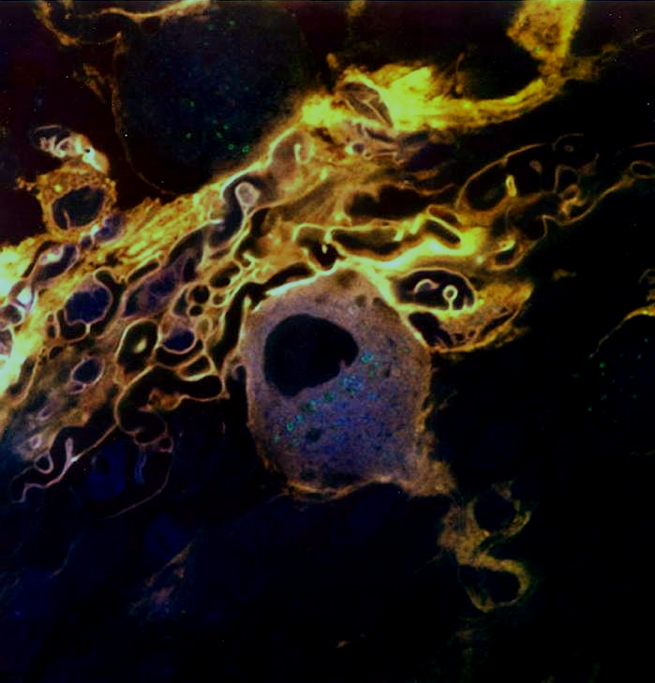
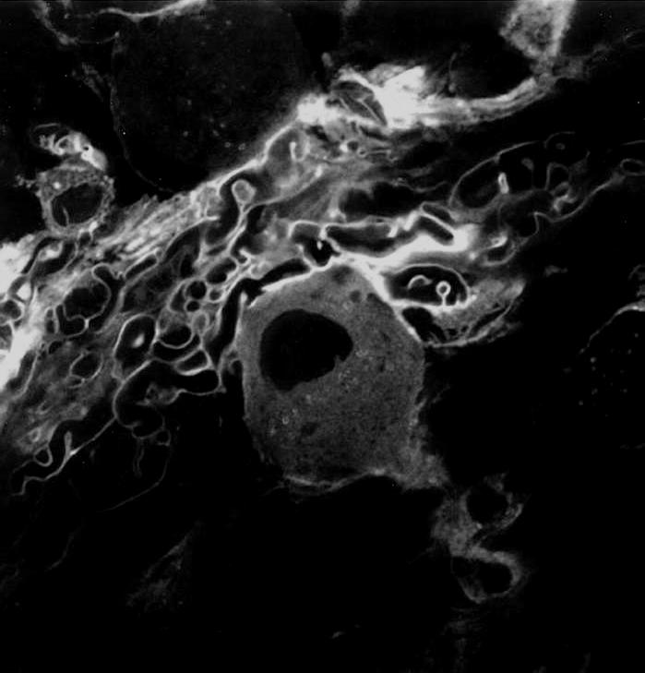
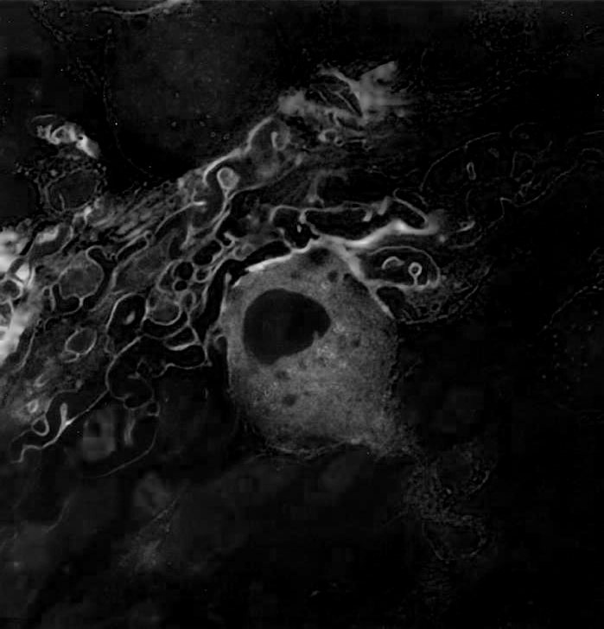
The M.U. MRC-1024 has 3 emission channels (3 PMT detectors) with spectral resolution of 30-40nm as defined by our filters
R
598/40nm
G
522/35nm
B
680/32nm

Slide 12
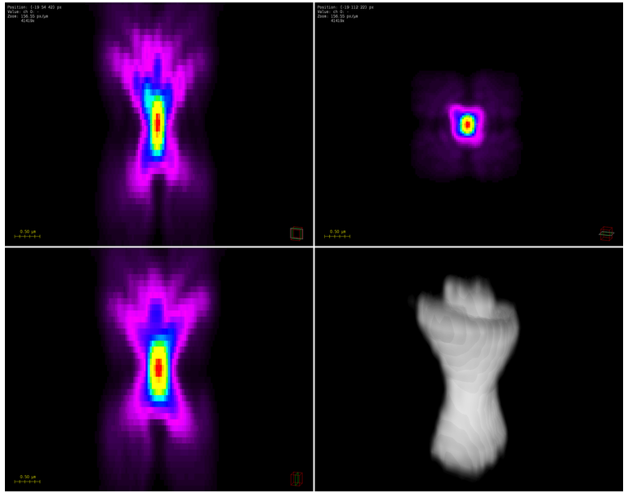
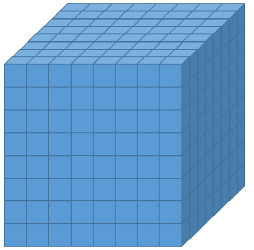
Voxels are 3D or volumetric pixels – e.g. in CSLM (confocal scanning laser) a 3D point spread function is assigned into 2D planar images one pixel at a time, then those 2D planar images are reconstructed into 3D voxels
When image is properly sampled, each pixel is derived from 2-3 (or more) of these PSFs
An example of an experimentally derived point spread function from a confocal microscope using a 63x 1.4NA oil objective. It was generated using Huygens Professional deconvolution software. Shown are views in xz, xy, yz and a 3D representation. Howard Vindin https://en.wikipedia.org/wiki/Point_spread_function
Also see: Cole, R., Jinadasa, T. & Brown, C. Measuring and interpreting point spread functions to determine confocal microscope resolution and ensure quality control. Nat Protoc 6, 1929–1941 (2011). https://doi.org/10.1038/nprot.2011.407
The PC reassembles the 2D pixels into a 3D volume with more or less (depending on the program used) of an attempt at improving accuracy and resolution.

