Slide 1
For Tim Corrigan - compilation of some spun on qdots in PVA or PMMA and imaged with either of 3 cameras - Nikon D50, EMCCD, or Leica confocal

Slide 2
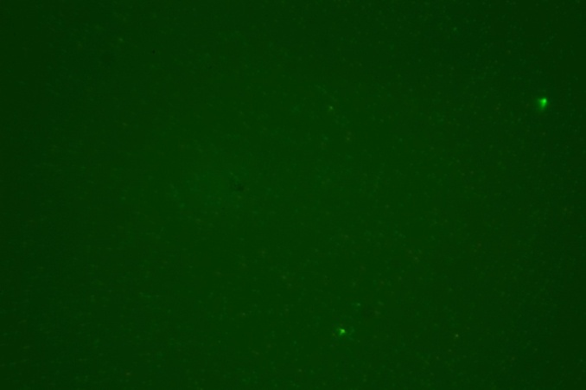
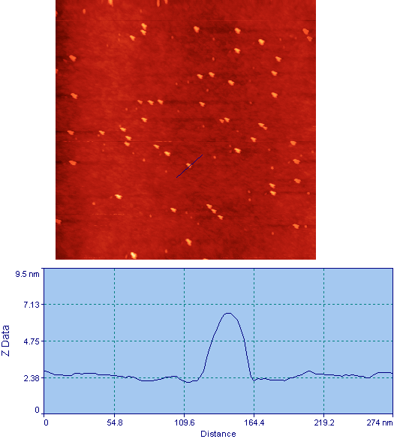
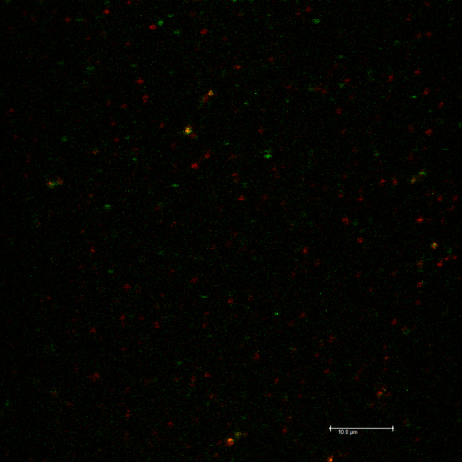
qdot/pmma test sample - 1% pmma with qdots, spun on glass (1nM 506ex/522em and .4nM 562ex/578em (nominal, CdSe, Evidentech)
left taken with tm AFM, check out the double tip artifact, one longer than the other, the shorter one is sharper
above Taken with cube in position 2 with Nikon D50 (em 510-600nm) - image is ~120um wide (consumer SLR)
below taken with leica sp5 left blurred (with software, 3x3 kernel), right raw data - this is with UV (405nm) excitation
true height is longest of the double tips

Slide 3
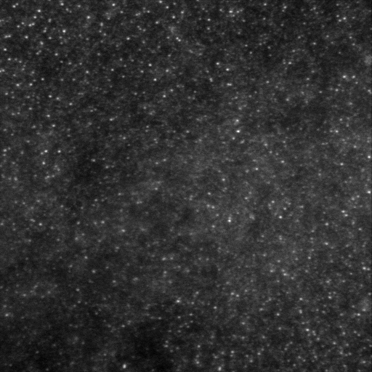
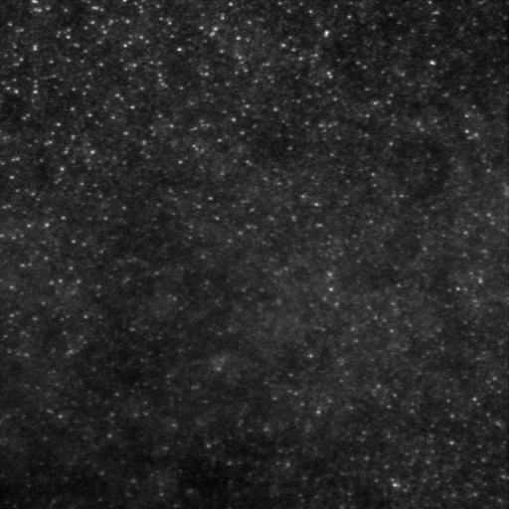
field of qdot ex506 in pmma dried on coverglass - field looks evenly illuminated - these are 2 fields from the same sample - illuminated with BH 473 laser - this is an emccd camera
2 separate 66umx66um fields
avg. pixel values in these quadrants 1-777 2-797 3-827 4-738 5-797 6-774 7-792 8-730
1
2
5
6
4
3
8
7

Slide 4
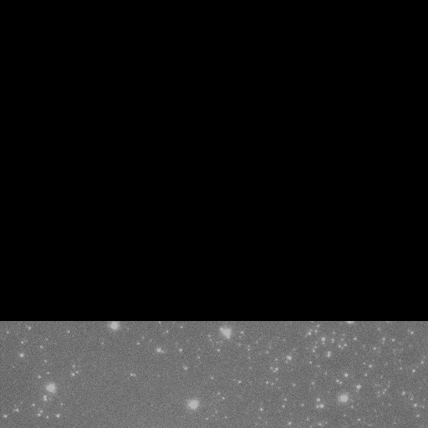
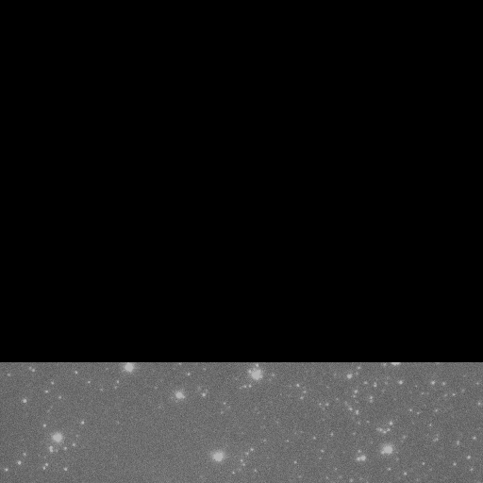
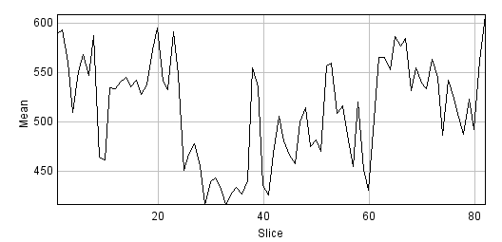
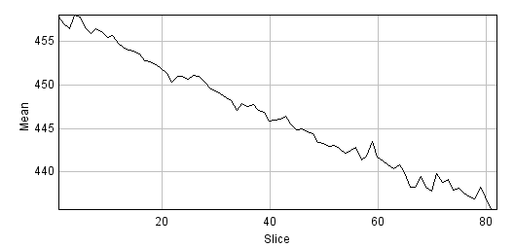
These are qdots in pmma 120msec-gfp-cube4-470-525.tif
these are taken with an EMCCD camera
qdots in pmma 470 ex filter with em filter at 525; display 0-1000 photons. 120msec-emgain 300
at qdot
Mean photons per exposure
0-10 seconds
time .120sec
background
Mean photons per exposure
time 10sec
0-10 seconds

Slide 5
Attempt at single particle spectroscopy and NSOM control object using qdots spin cast onto glass in .5% poly-vinyl alcohol (PVA). David Neff 1/28/11
two qdot types were used 506ex/522em and 562ex/578em (CdSe, Evidentech)
PVA (77kDa avg. molecular weight) was dissolved in warm (~65 deg. C) water
Both qdots were added to the same 1ml of PVA solution: 3ul of 522em with original conc. 108uM for final conc. of 324nM AND 3ul of 578em with original conc. 36um for final conc. of 108nM
~300uL was dropped onto center of 22mmx22mm coverslip
500 RPM 10sec, 2000 RPM 2 minutes (PVA seemed to be dry, no evidence of pooling or edge bead
areas analyzed here showed either nice even coverage or string like clumping
Position 2 is 505lp dichroic & 510lp emission stacked with 605sp (Nanonics), position 3 is 505lp dichroic & 535/40 band pass emission filter

Slide 6
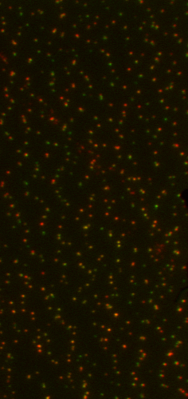
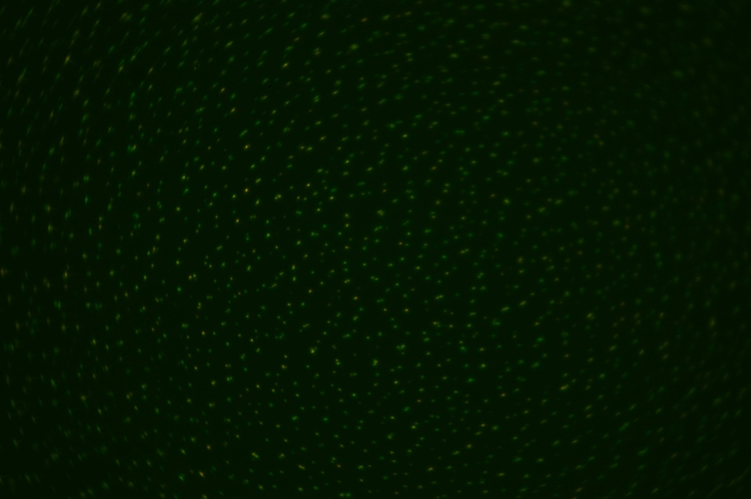
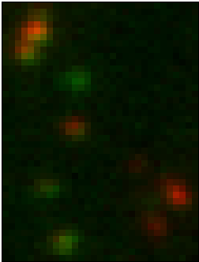
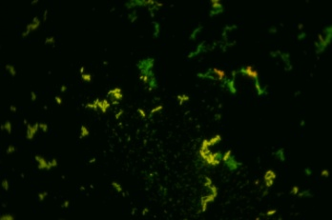
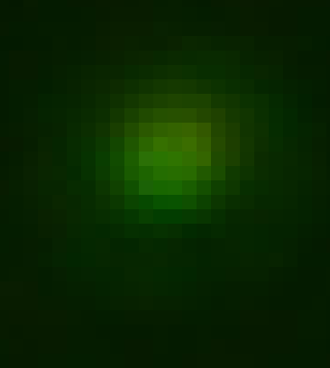
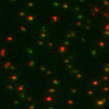
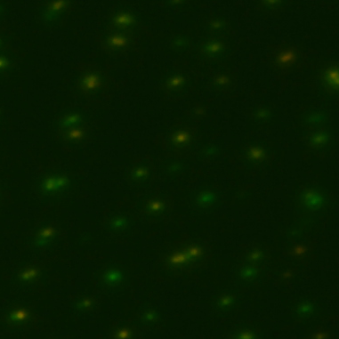
with additional 630sp filter under cube (em filt is 510 LP) inset bottom left is other region of sample showing strings and clumps of qdot/pva, right inset is single qdot showing spread over multiple pixels
Notice pixels in this small screen capture below, Powerpoint blurs the image at bottom so pixels are invisible.
Left: Optisplit with EMCCD camera (128nm/pixel) vs Right: NikonD50 slr (40nm/pixel),
15x15um
15x15um

